Slide 1
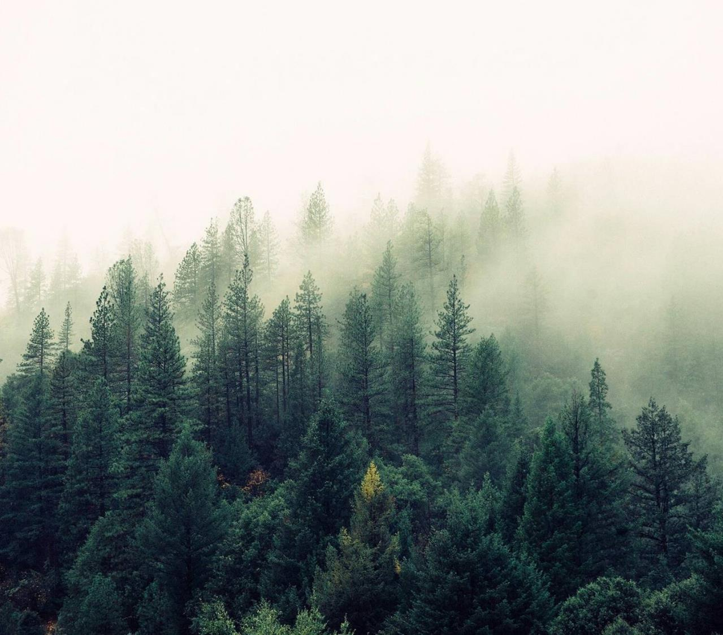
Mushrooms!!!

Slide 2
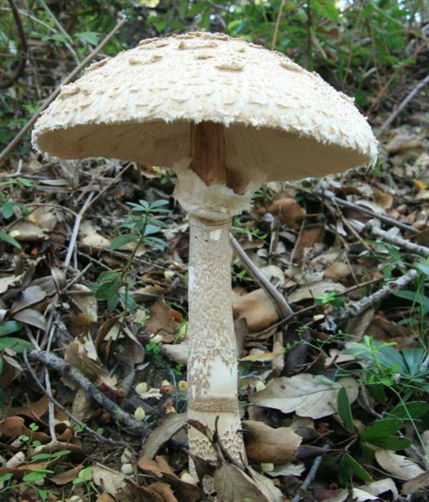
Parasol mushroom or Macrolepiota procera

Slide 3
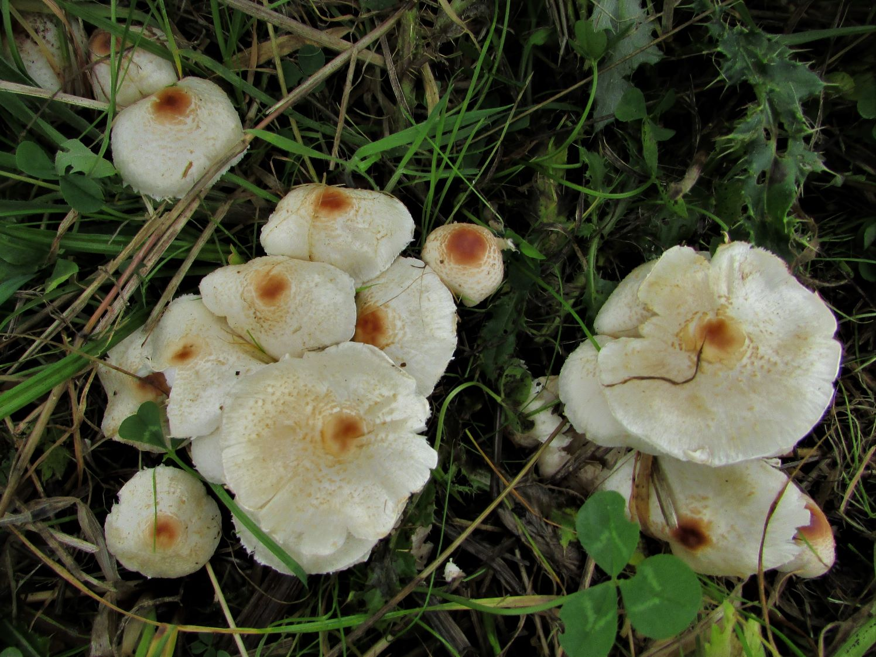
The Stinking Dapperling or Lepiota cristata

Slide 4
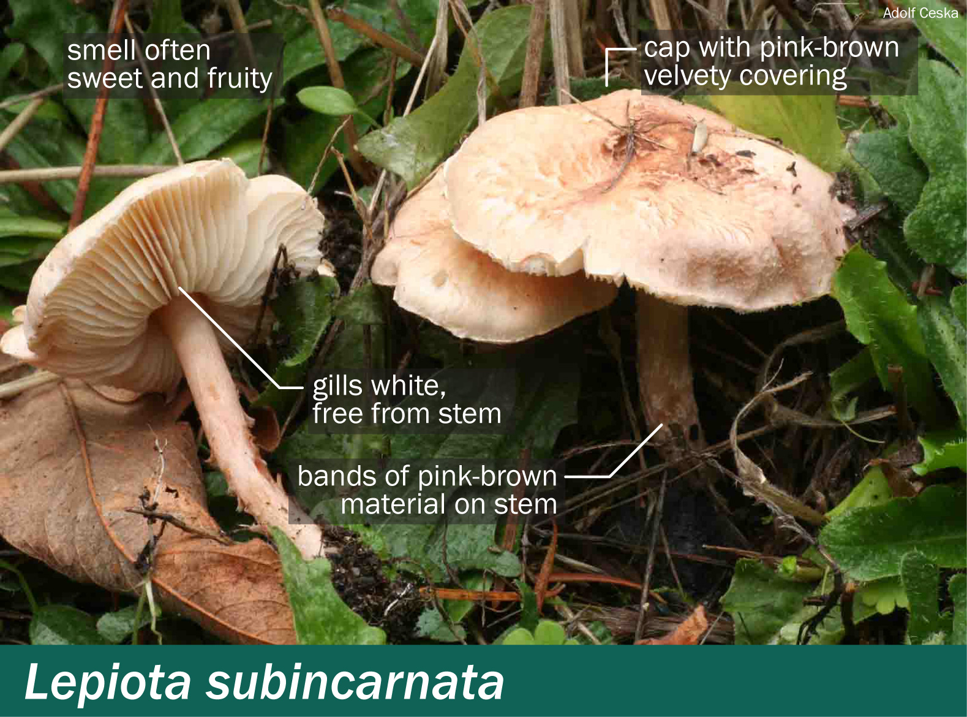
The Deadly Parasol or Lepiota subincarnata

Slide 5
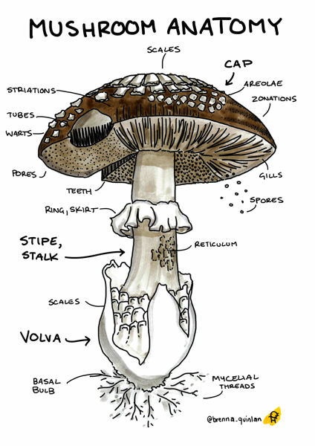
Basic mushroom anatomy
Cap -> shape, surface, colour
Bruises
Odor
Gill -> attachment, spacing, size, colour
Stalk -> shape, root, surface above ring, surface below ring, colour above ring, colour below ring
Veil -> type, colour (volva is the remnant of the veil)
Ring -> number, type
Spore print colour – a method of identifying mushrooms that consists of the colour deposit of the powder of spores on a surface
Population
Habitat

Slide 6
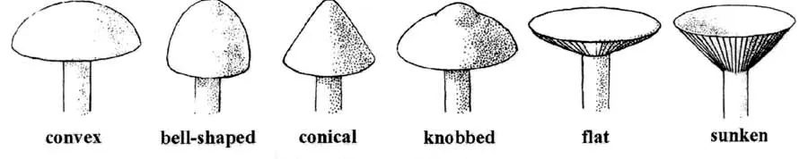
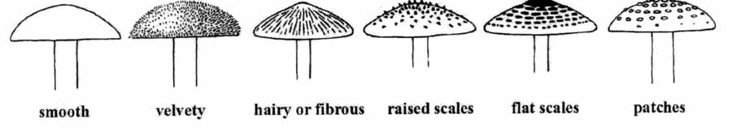
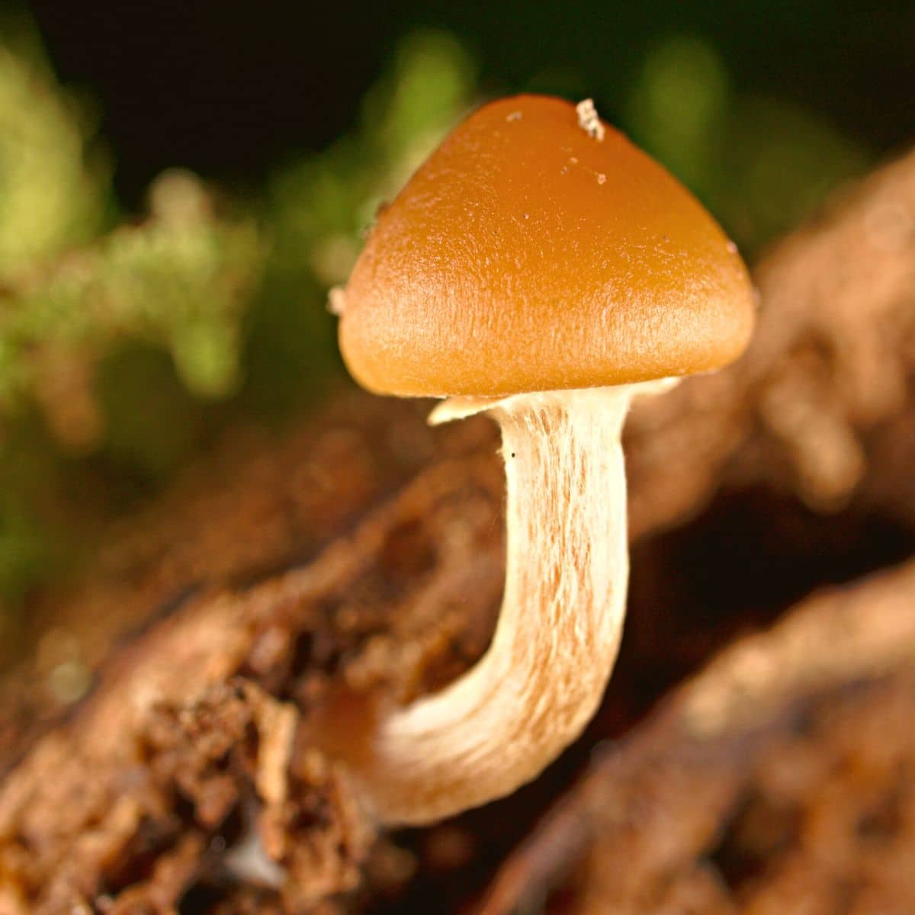
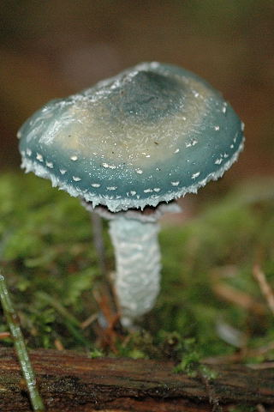
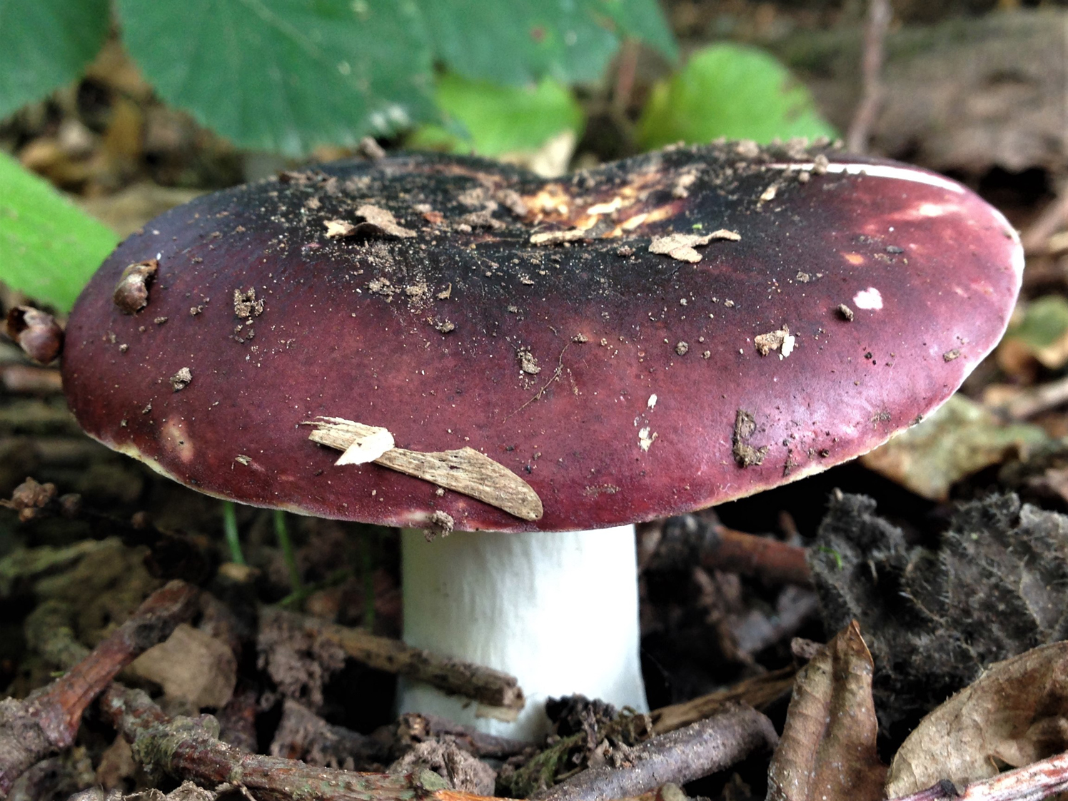
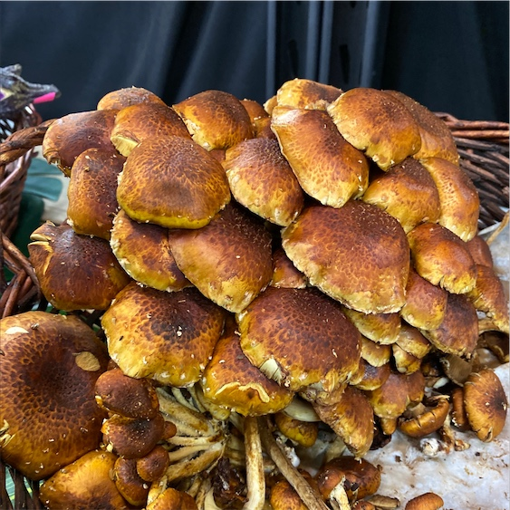
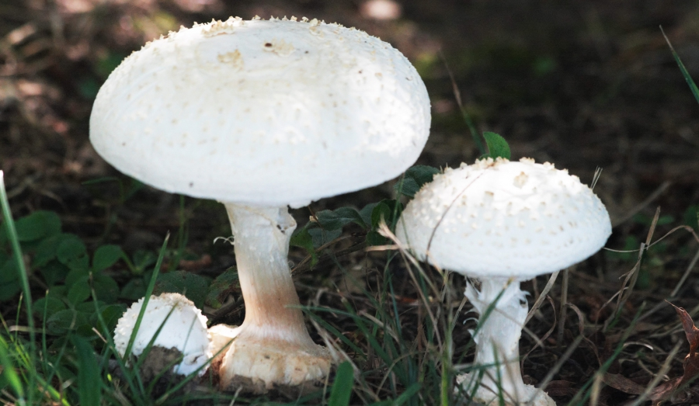
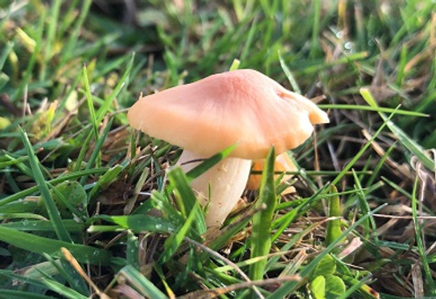
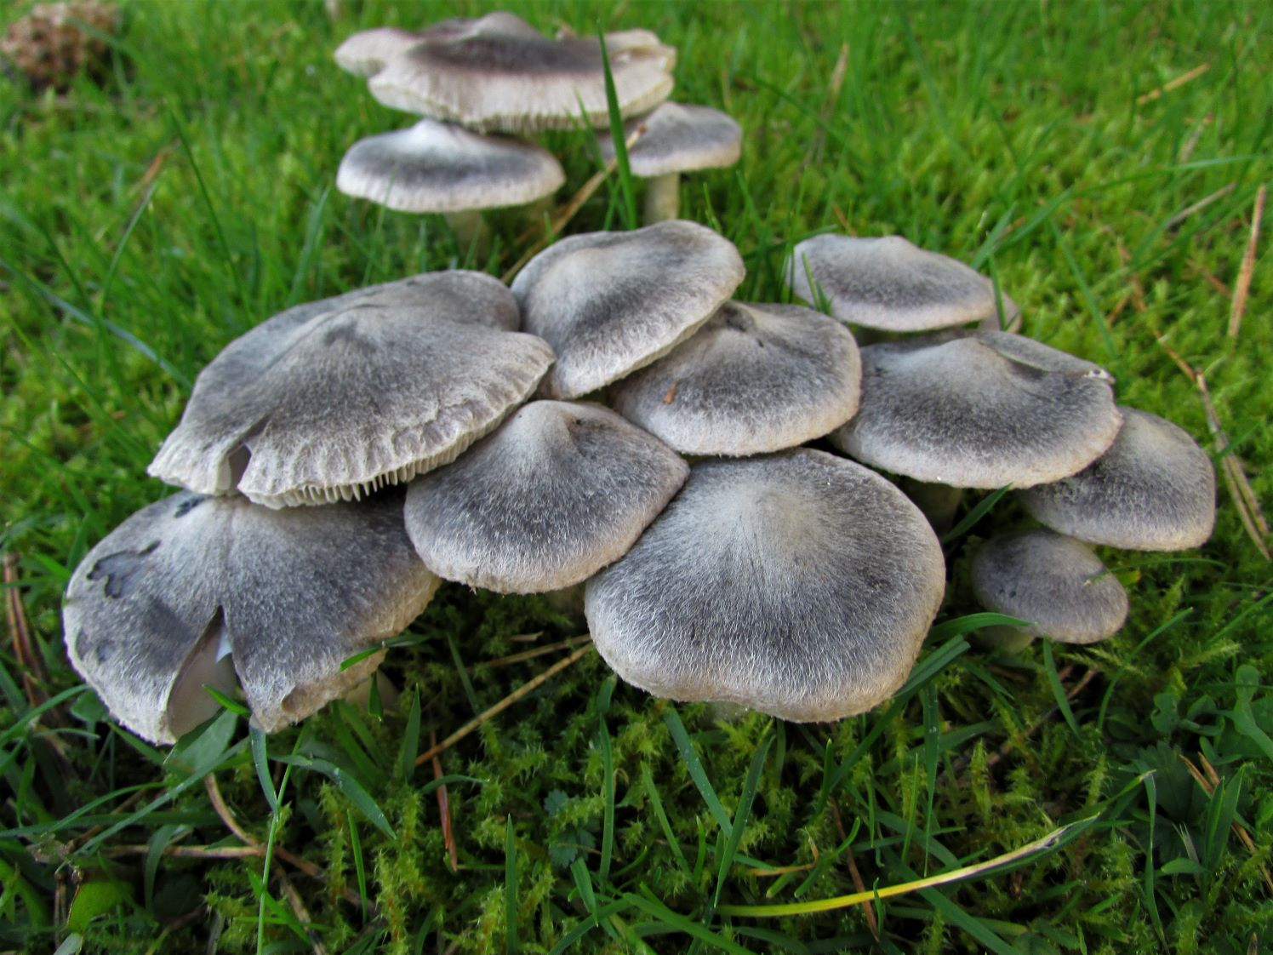
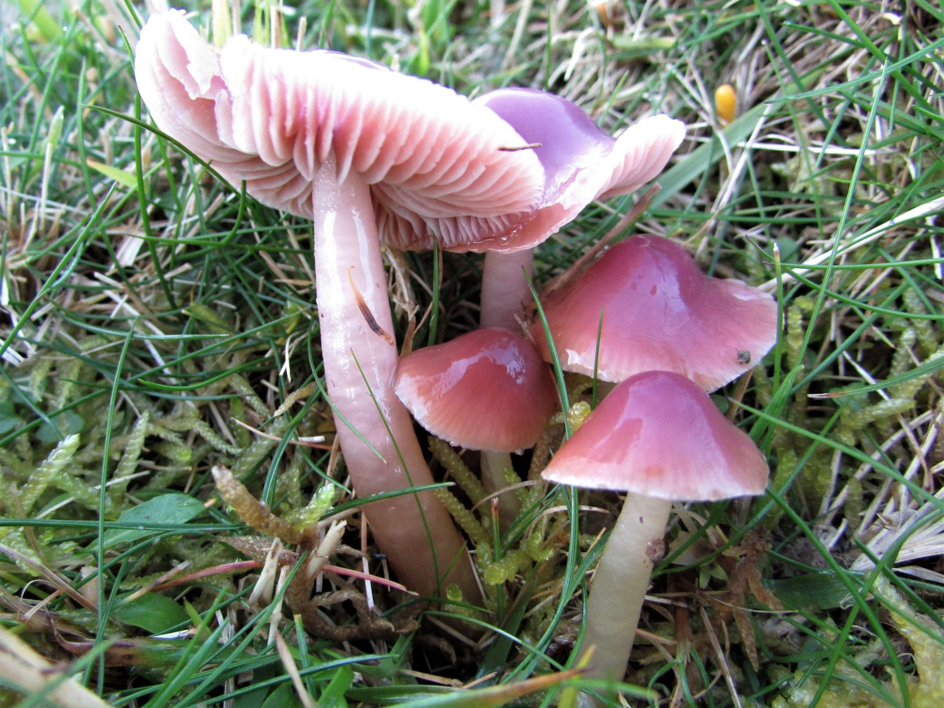
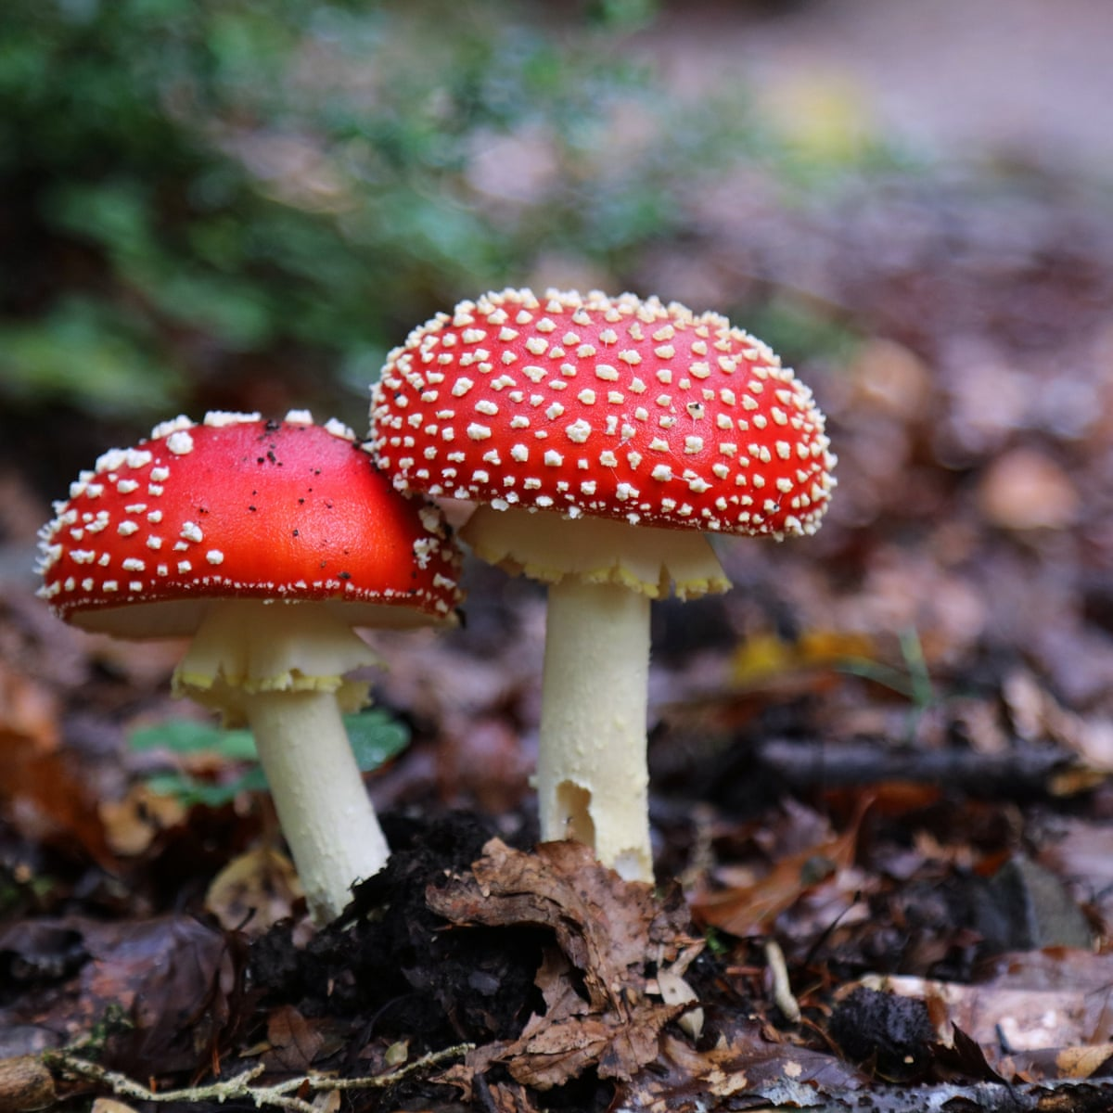
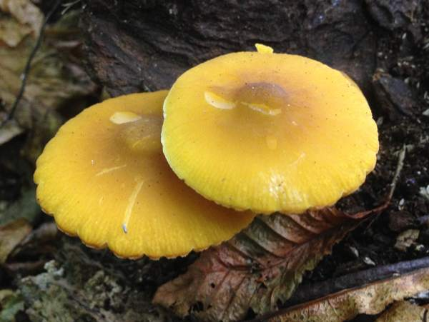
Cap shape
Cap
Cap surface
Cap colour
*please note that I did not cross check whether all of these mushrooms are part of the correct species for this dataset
buff
red
gray
pink
yellow
brown
cinnamon
green
purple
white

Slide 7
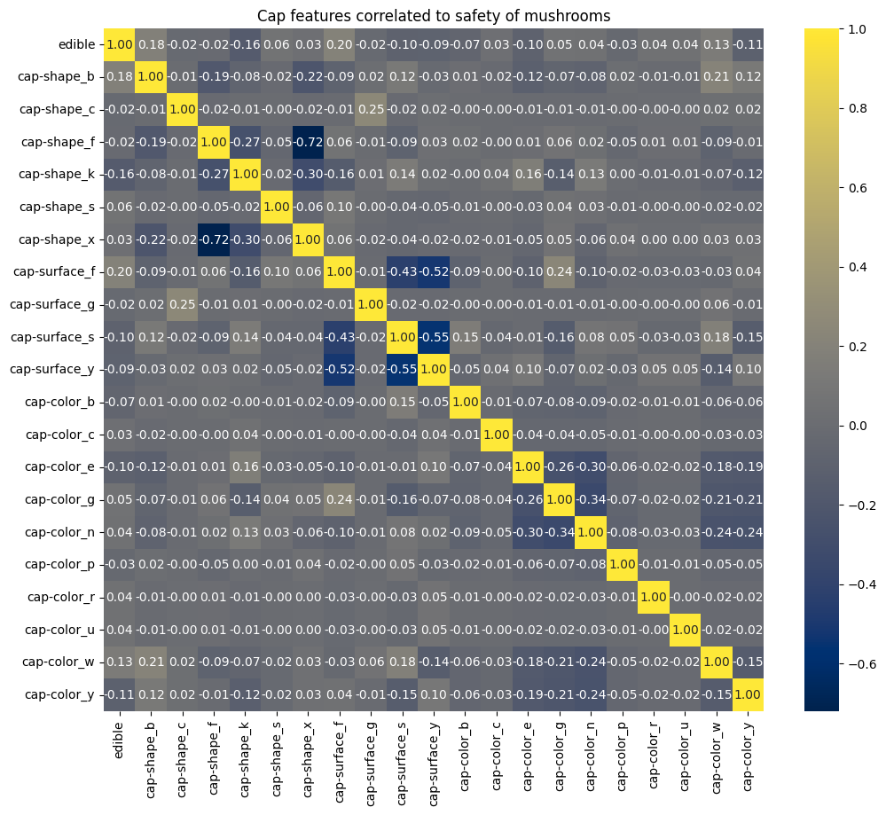
Cap features correlated to safety of mushrooms
We don’t see any significant correlation

Slide 8



Edible vs poisonous according to cap features

Slide 9
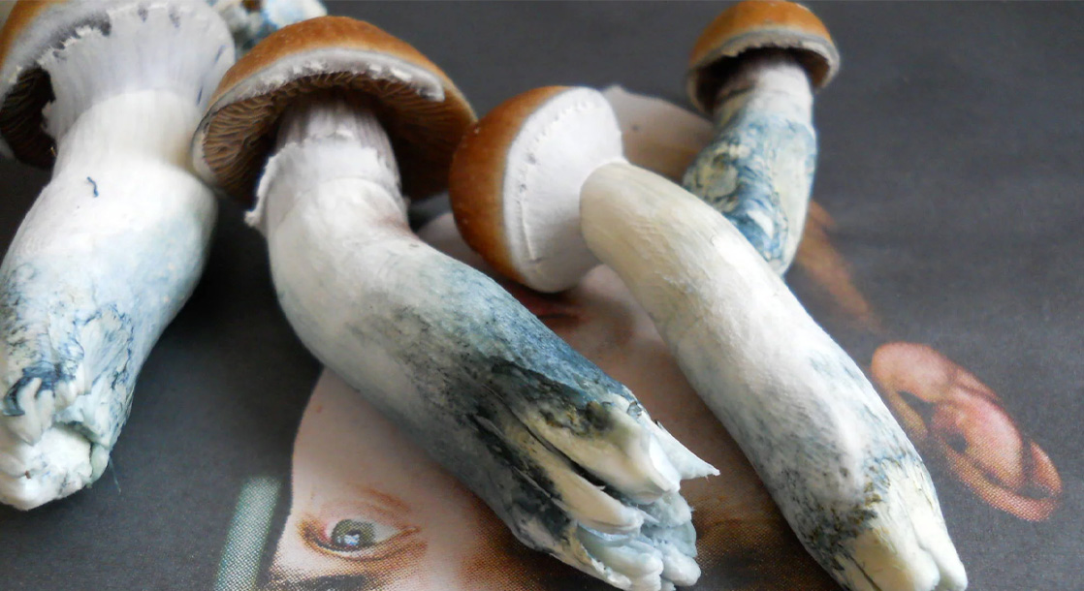
Bruises
All mushrooms bruise – this doesn’t indicate anything without the colour of the bruising
We don’t have the colour of the bruising
Therefore I have dropped this column
Remember each row indicates one sample of a mushroom – bruising may simply indicate how this specific sample was handled/picked up etc

Slide 10
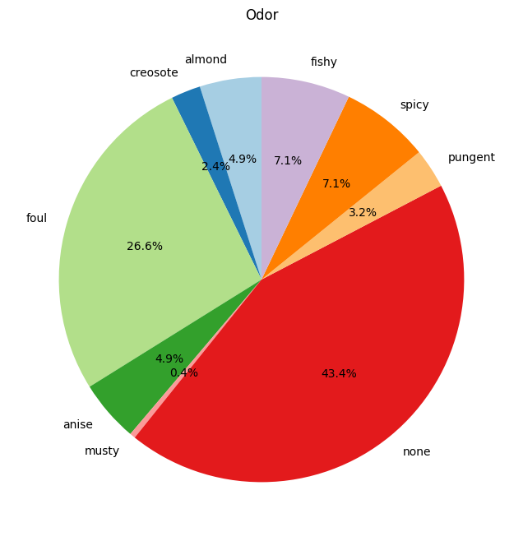
Odor
almond=a
anise=l
creosote=c
fishy=y
foul=f
musty=m
none=n
pungent=p
spicy=s

Slide 11
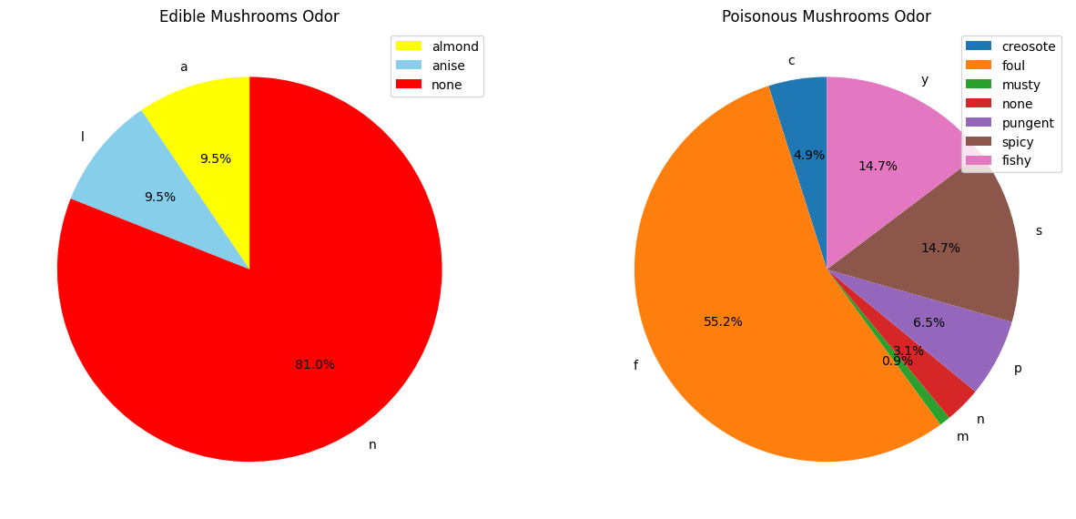
Mushroom odor in edible vs poisonous

Slide 12

Sunburst chart of odor in edible vs poisonous mushrooms

Slide 13
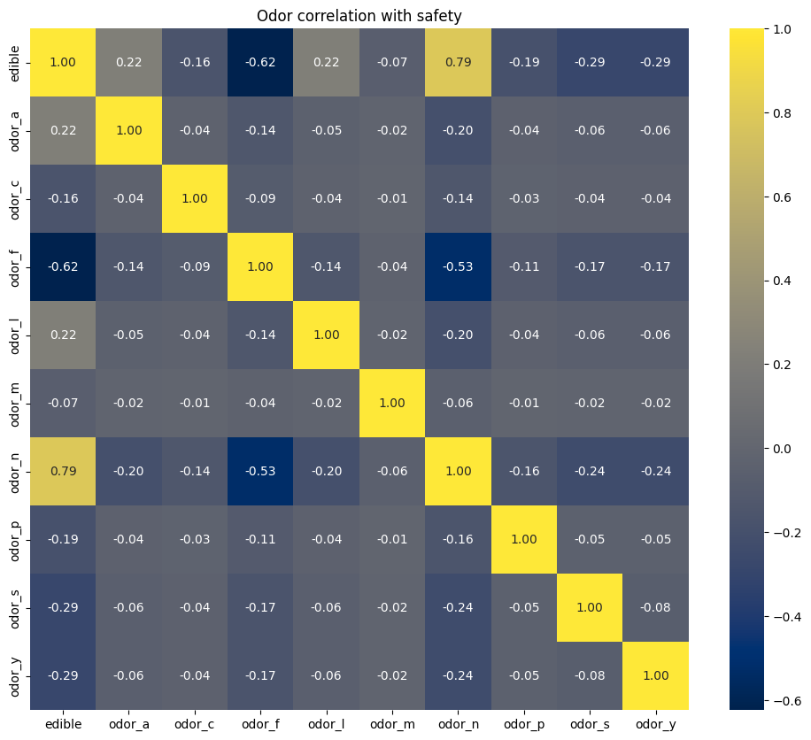
Odor correlation with mushroom safety
We can see a very strong (0.8) correlation between edible and having no smell – this makes sense given the pie charts we’ve seen
We can also see a strong correlation (0.6) between poisonous and foul smell – also tracks with the pie chart

Slide 14
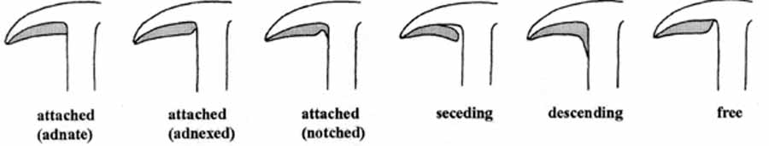
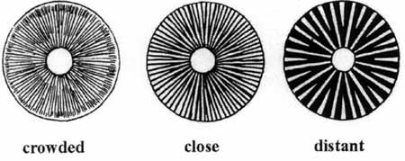
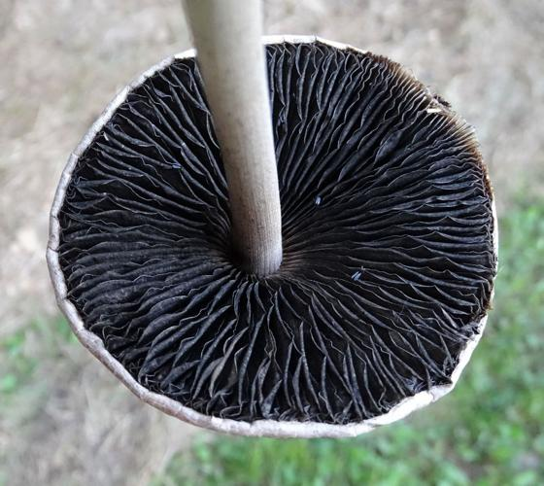
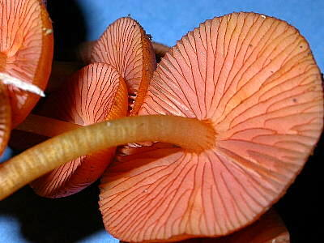
Gill attachment – attached, notched, descending, free
Gills
Gill spacing
Gill size – broad or narrow
Gill colour – same as cap colour with the addition of black and orange

Slide 15
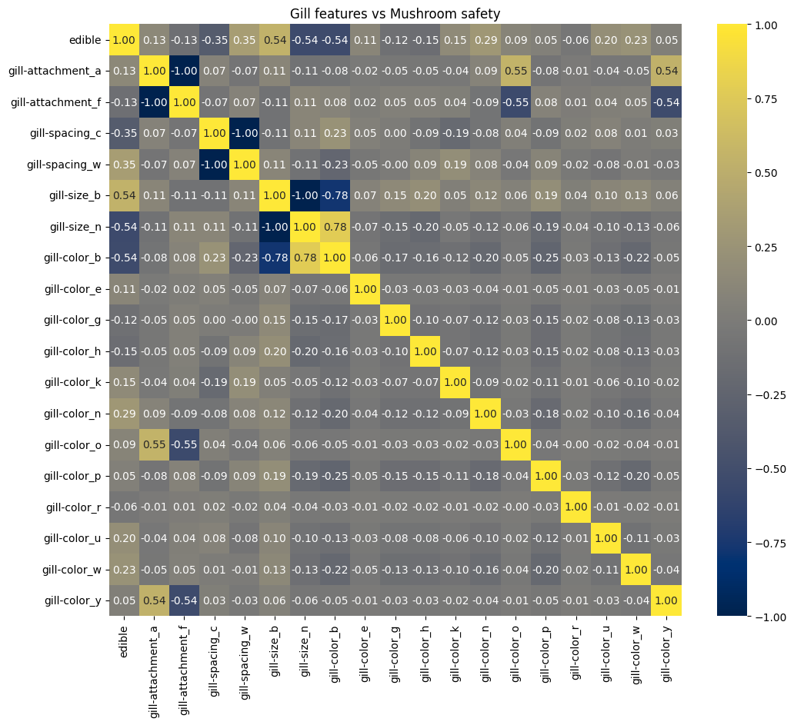
Gill feature correlation with mushroom safety
Moderate correlation between edible and broad gill size
Moderate correlation between poisonous and narrow gill size as well as buff gill colour

Slide 16
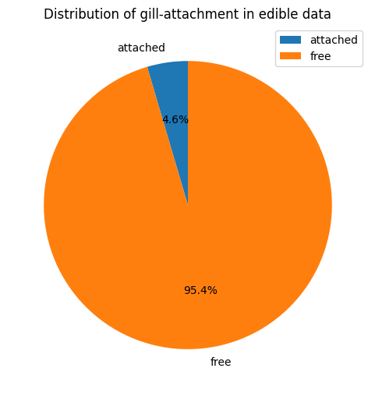
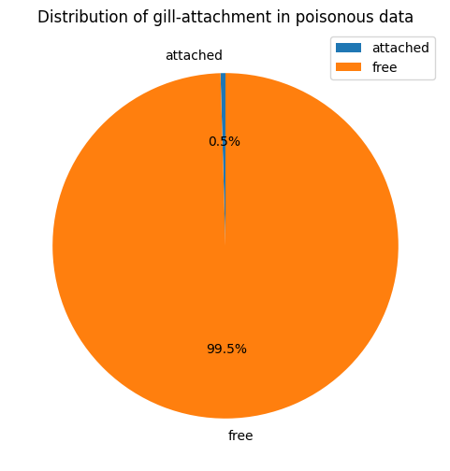
Gill attachment
Even though there are 4 possible values, we only have 2 in our data set

Slide 17
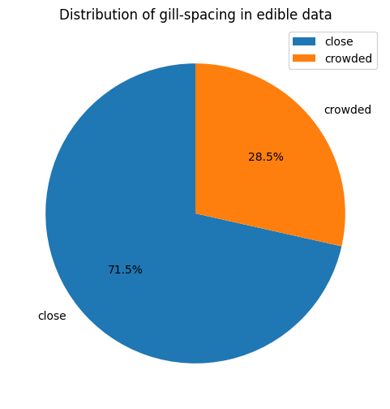
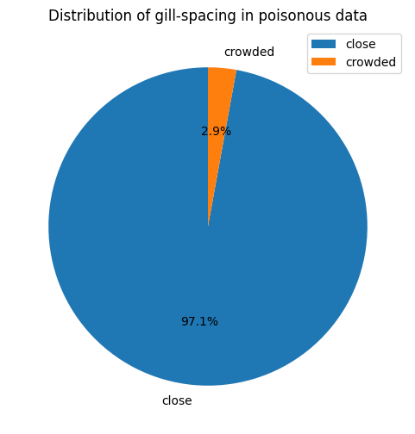
Gill spacing
3 values possible, but only 2 in our samples

Slide 18
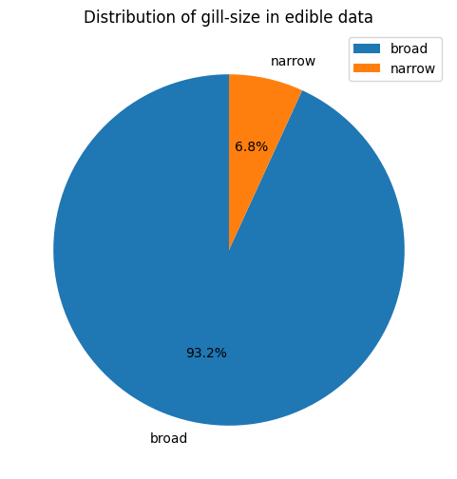
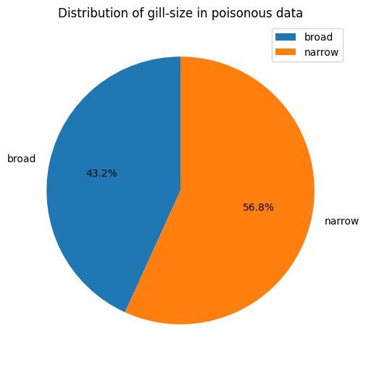
Gill size
3 values possible, but only 2 in our samples

Slide 19
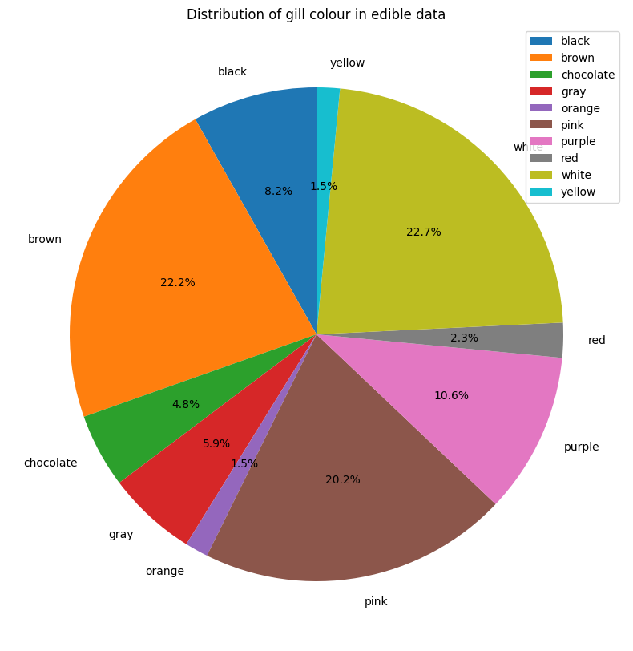
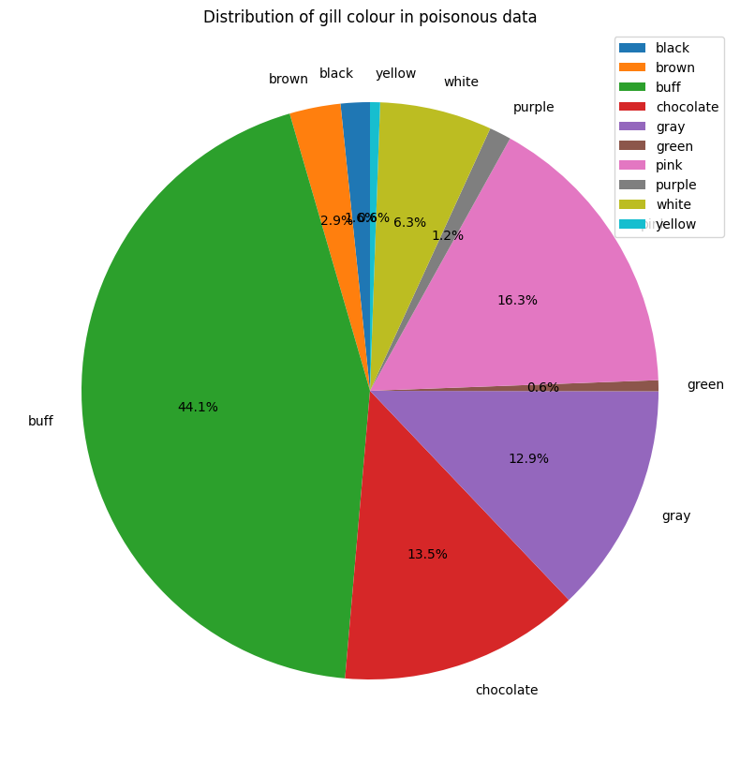
Gill colour
We can see a lot of poisonous mushrooms have buff gills, whereas edible are more evenly distributed

Slide 20
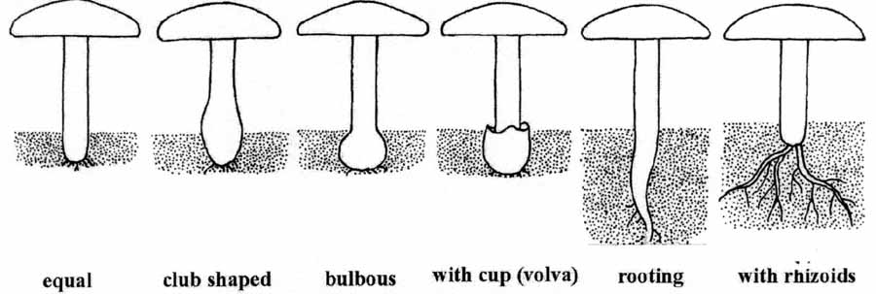
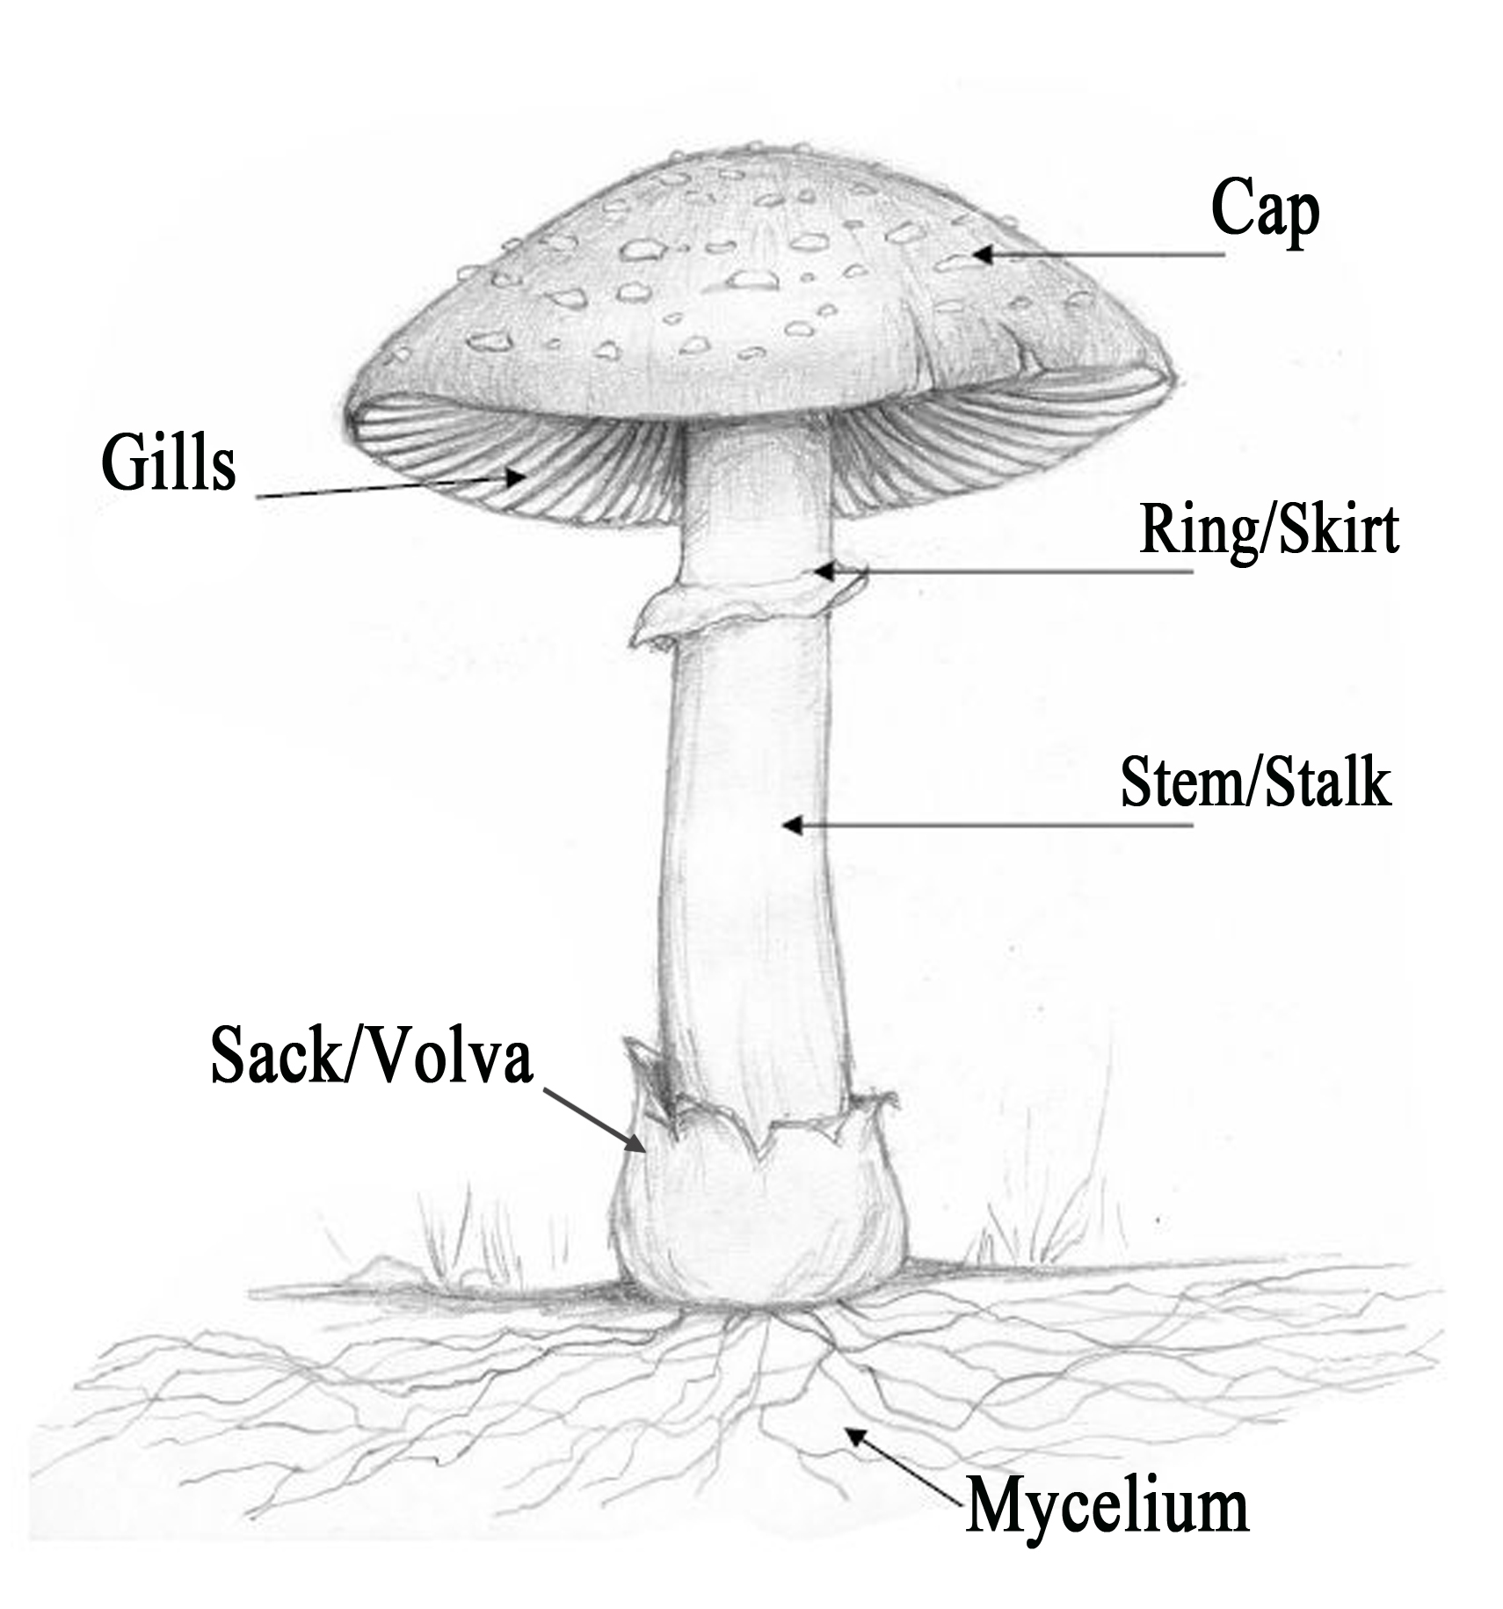
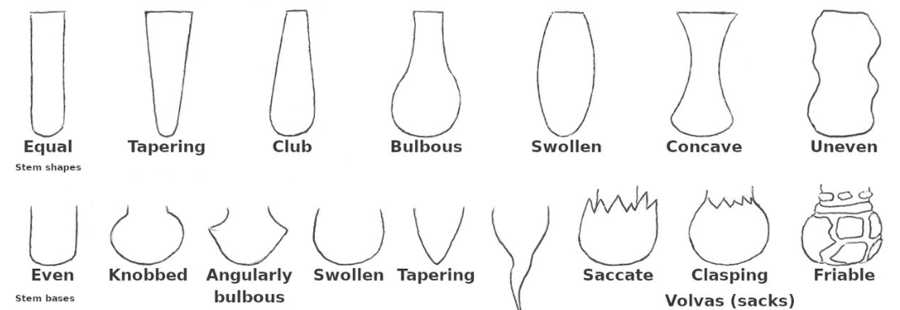
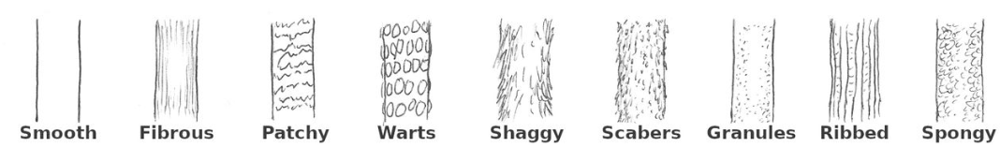
Stalk shape – enlarging or tapering
Stalk root – bulbous, club, cup, equal, rhizomorphs, rooted, missing values
Stalk
For some reason stalk shape and root are separate values, though the information I could find doesn’t seem to differentiate too strongly between them
Stalk surface texture above and below ring – fibrous, scaly, silky, smooth
Stalk colour above and below ring

Slide 21
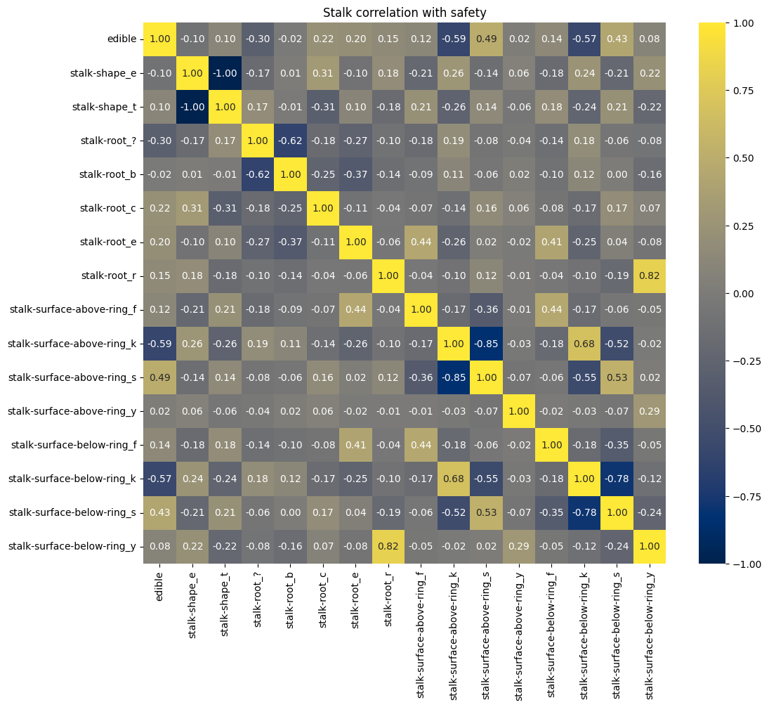
Stalk shape, root, surface above and below ring correlation with mushroom safety
Moderate correlation between edible mushrooms and smooth texture above ring
Moderate correlation between poisonous mushrooms and silky texture above and below ring

Slide 22
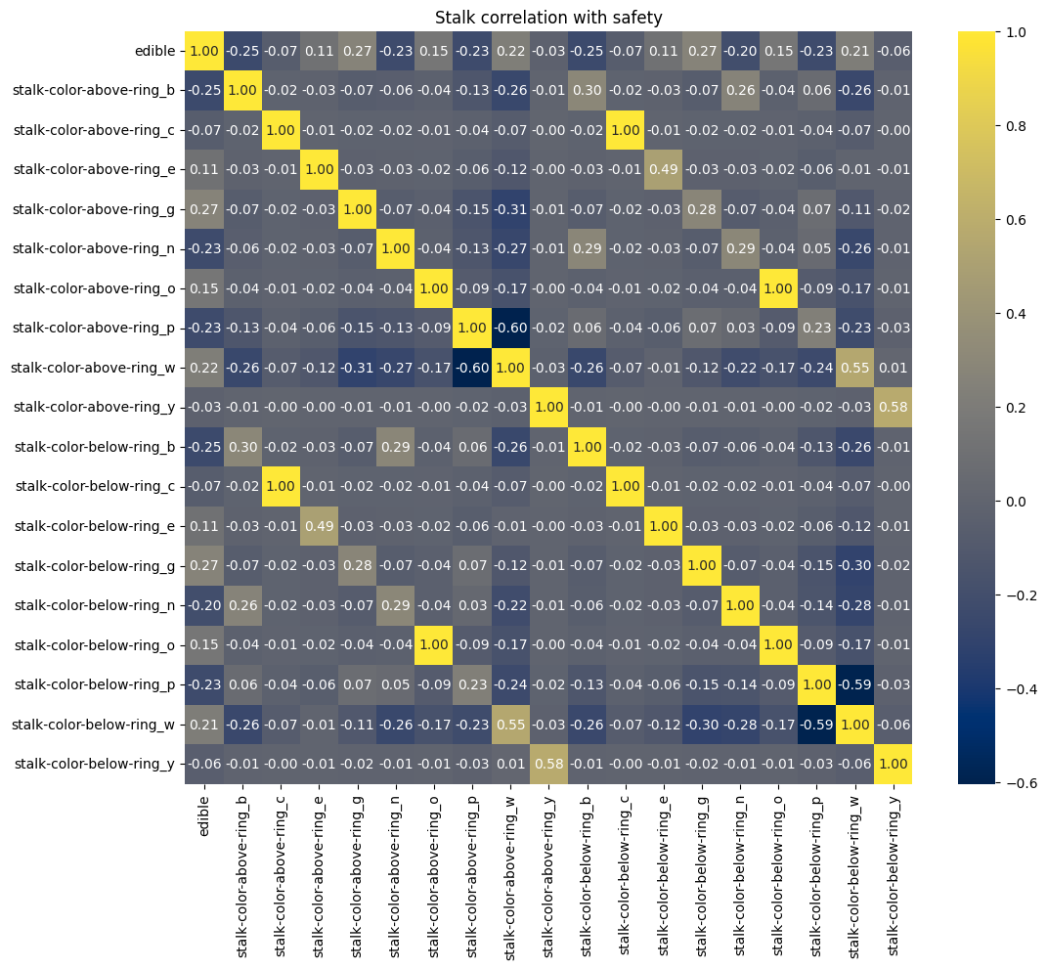
Stalk colour above and below ring correlation with mushroom safety
Values aren’t particularly correlated

Slide 23
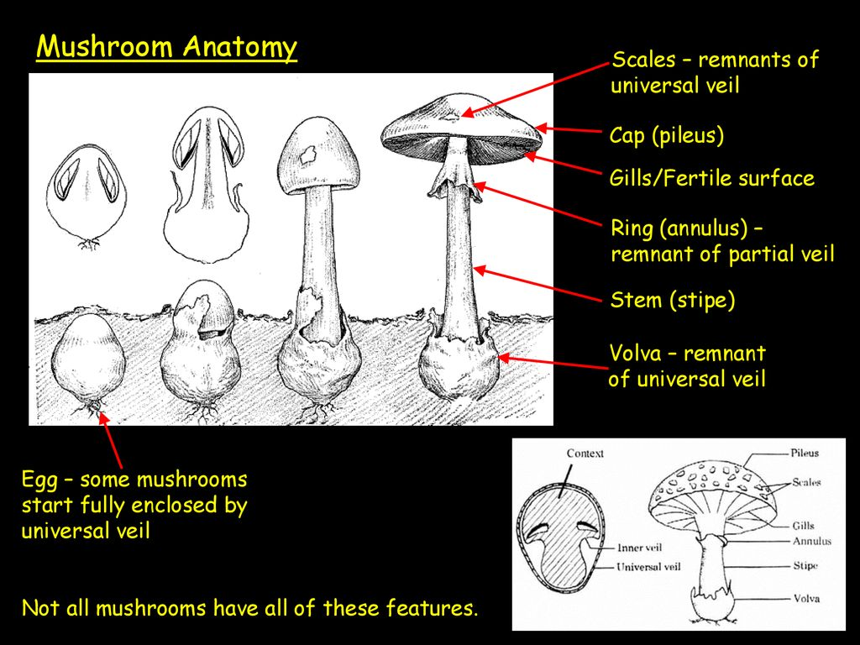
Veil
Veil type – partial or universal
Veil colour
Despite what the data may suggest, partial and universal veils are not different types of the same thing!
They are in fact 2 different features that a mushroom can have at the same time (or not have, according to the mushroom!)
The universal veil covers the immature mushroom and rips as it grows, becoming the volva
The partial veil covers the immature lamellae and also rips as it grows, becoming the ring or annulus

Slide 24
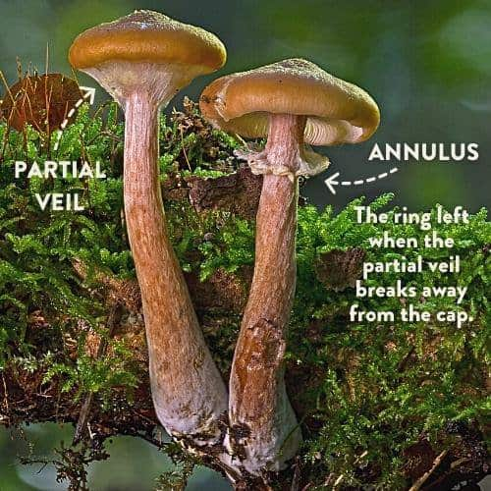
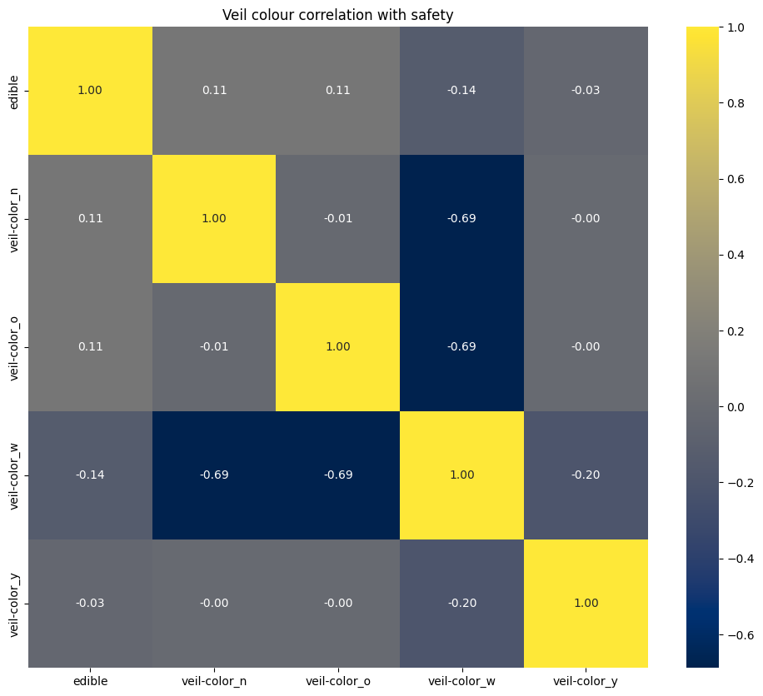
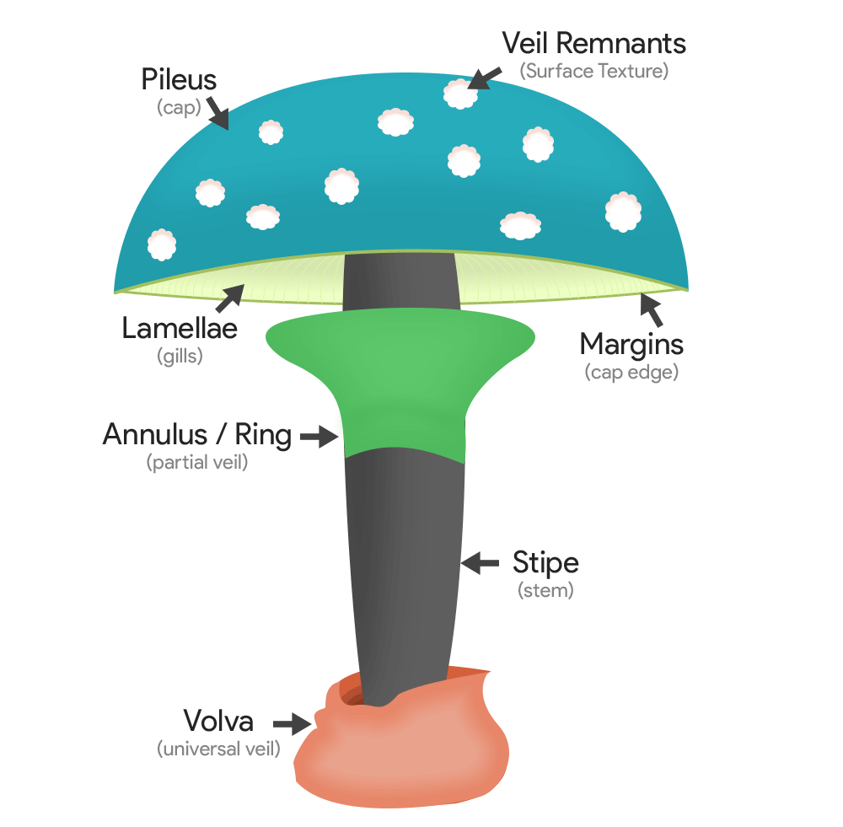
Veil colour correlation matrix
Veil
No significant correlation seen between features

Slide 25
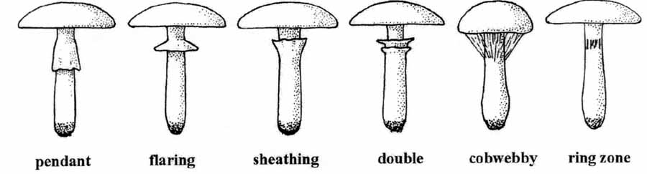
Ring – remains of the partial veil
Ring number – 0/1/2
Ring type

Slide 26
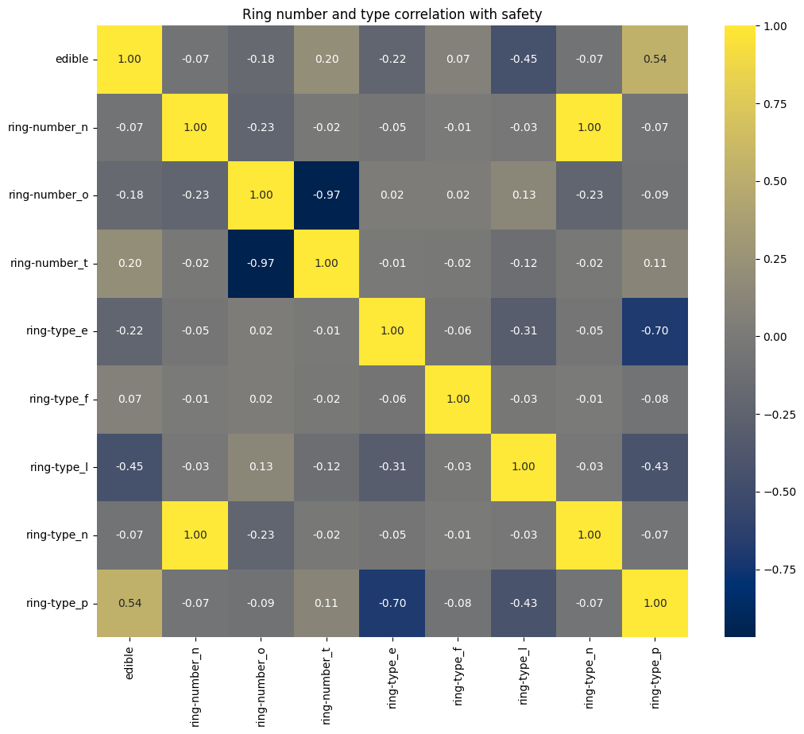
Ring number and type correlation with mushroom safety
Some moderate correlation between edible mushrooms and pendant ring
Some moderate correlation between poisonous mushrooms and large ring

Slide 27
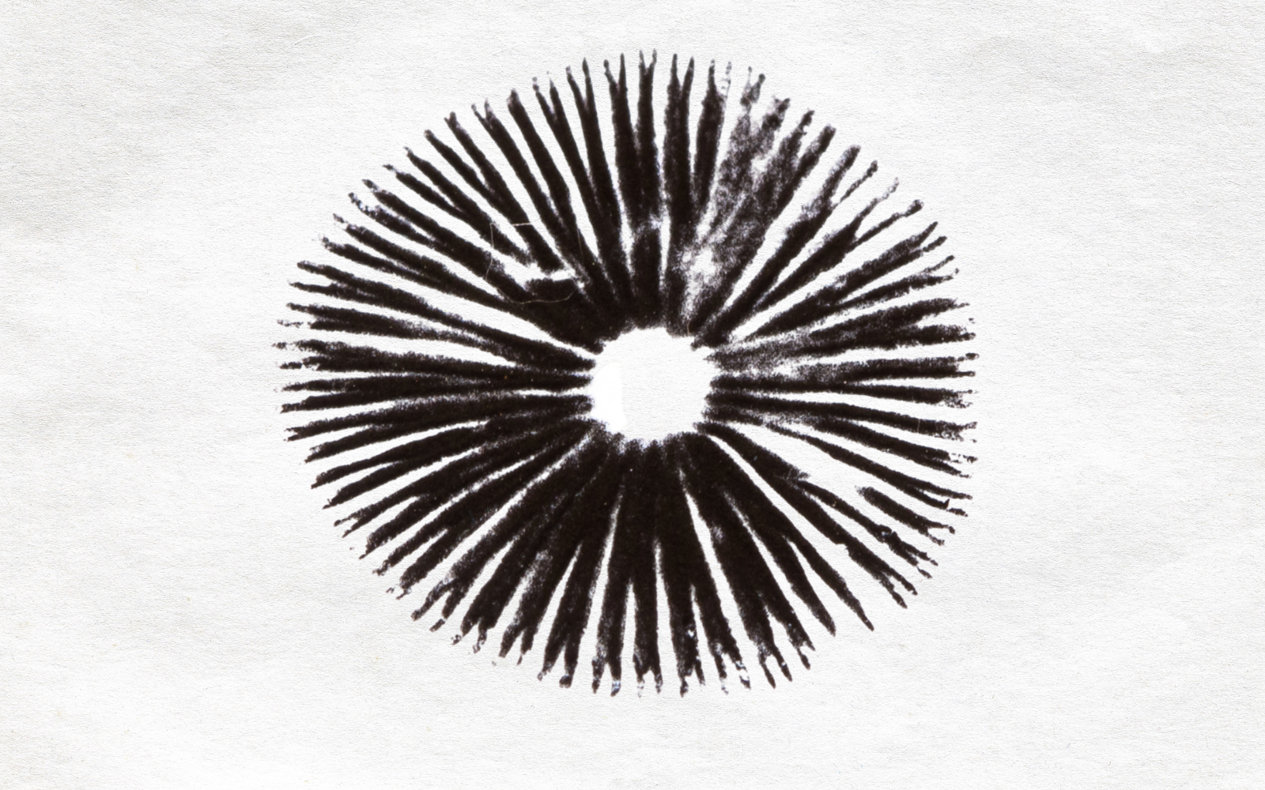
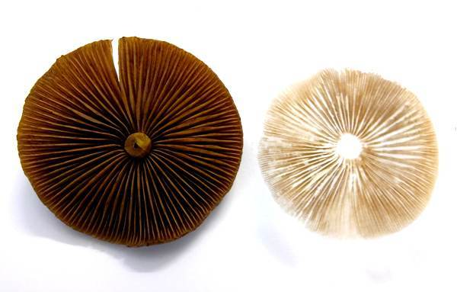
Spore print colour
A spore print is obtained by taking the cap of a mushroom and placing it on top of a surface
Then you allow the spores to deposit on the surface and assess the colour

Slide 28
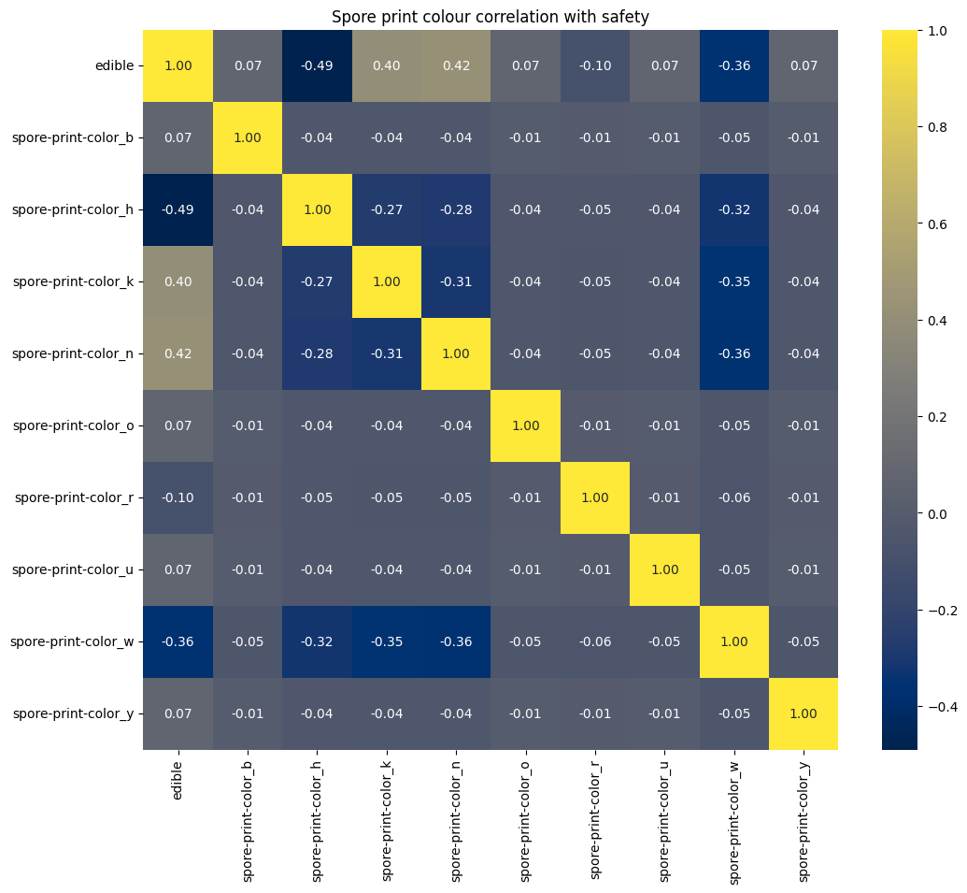
Spore print colour correlation with mushroom safety
Some moderate correlation between edible mushrooms and black and brown spore print
Some moderate correlation between poisonous mushrooms and chocolate and white spore prints

Slide 29

Population correlation with mushroom safety
Some moderate correlation between poisonous mushrooms and ‘several’ population

Slide 30

Habitat correlation with mushroom safety
Some small correlation between poisonous mushrooms and mushrooms growing on paths

Slide 31
Features with moderate to strong correlation
Edible features
Poisonous features
No odour
Broad gill size
Smooth stalk surface above ring
Pendant ring type
Black and brown spore print
Foul odour
Narrow gill size
Buff gill colour
Silky stalk surface above and below ring
Large ring type
Chocolate and white spore print
Population of several

Slide 32


Prediction models
Naïve bayes: 92.8%
Logistic regression: 97.6%

Slide 33

Prediction models
kNN: 98.1%
decisiontree gini&entropy: 98.1%

Slide 34

Prediction models
Decision tree max depth: 93.7%

Slide 35

Prediction models
SVM Linear: 97.6%
Svm sigmoid: 93.5%

Slide 36

Prediction models
Svm rbf: 98.2%
Random forest: 98.1%

Slide 37


Summary
Could be interesting to see if we can use clustering techniques to detect species – we know the samples are from 23 species but we don’t have any indication of which species (we know genus Lepiota and Agaricus)
Would using all features rather than those with some correlation fare better?
I haven’t checked the correlation *between* the features we’ve chosen – could they be correlated, in which case we should drop some?
Could make an app where you input the 16 features and you get a predicted result

Slide 38


Thank you!

